Slide 1
Fruitful-Tree Count management
Yhya Altroudi Mostafa Alrahal
Nabil Ghosn Wissam Zoudi
8/20/2025

Slide 2
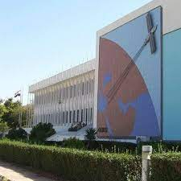
General Organization of Remote Sensing
2

Slide 3
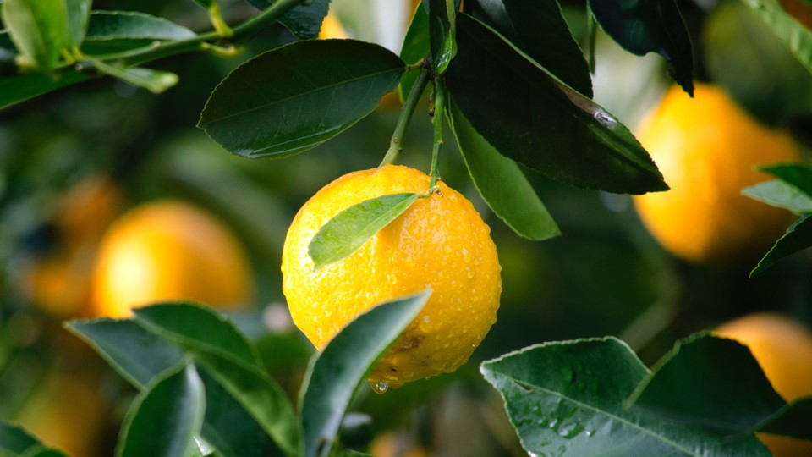
An essential need
3

Slide 4
Motivations
And
Justification
4

Slide 5

An alternative to manual counting
5

Slide 6
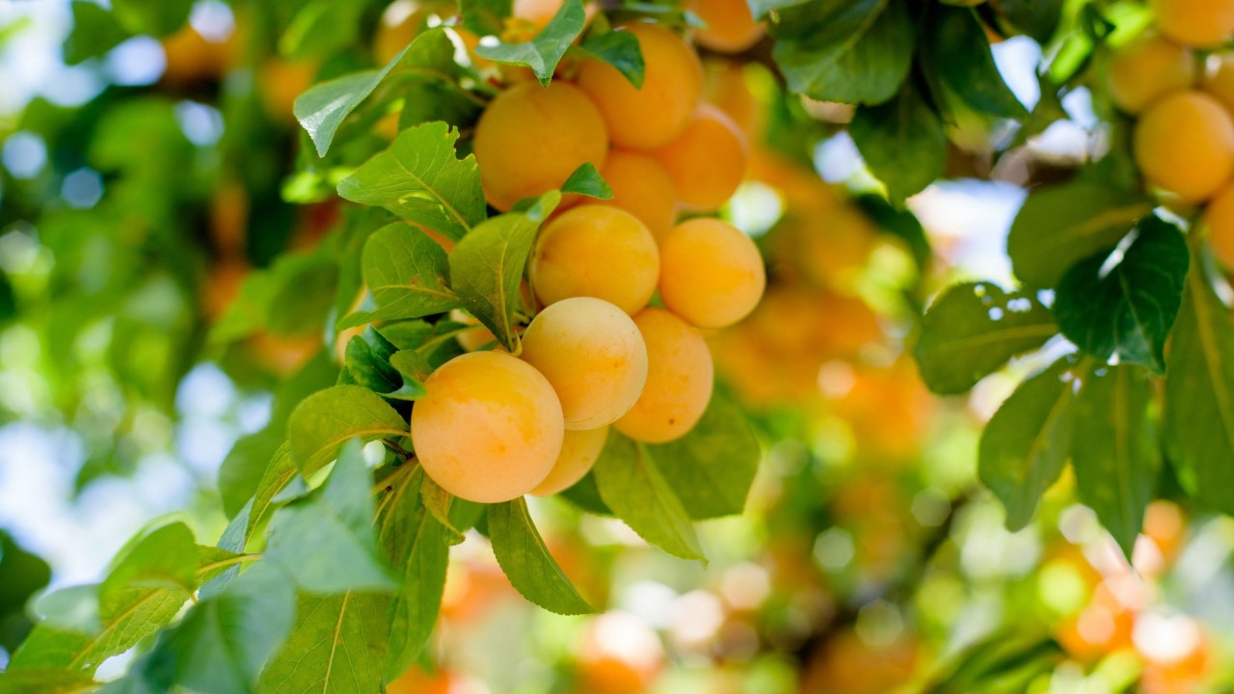
System Description
6

Slide 7
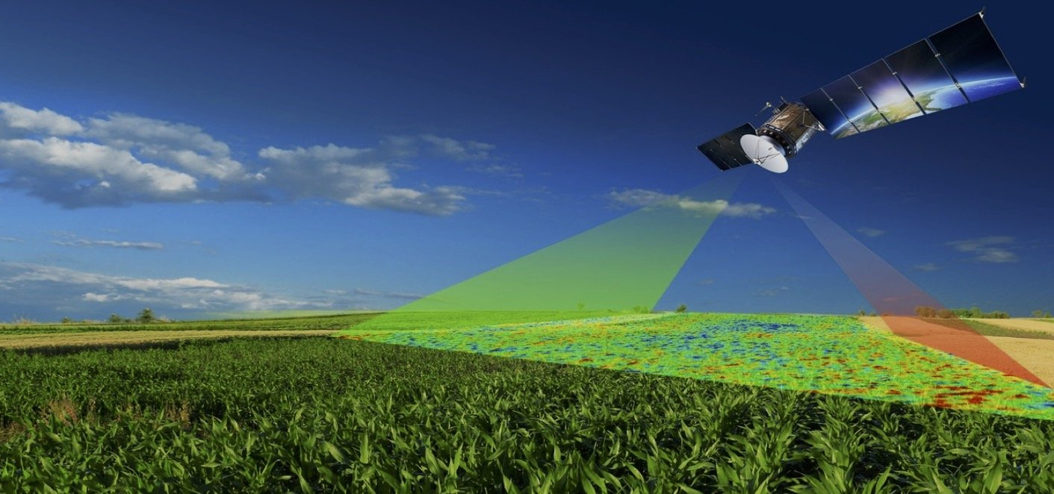
11
Farm Management
7

Slide 8
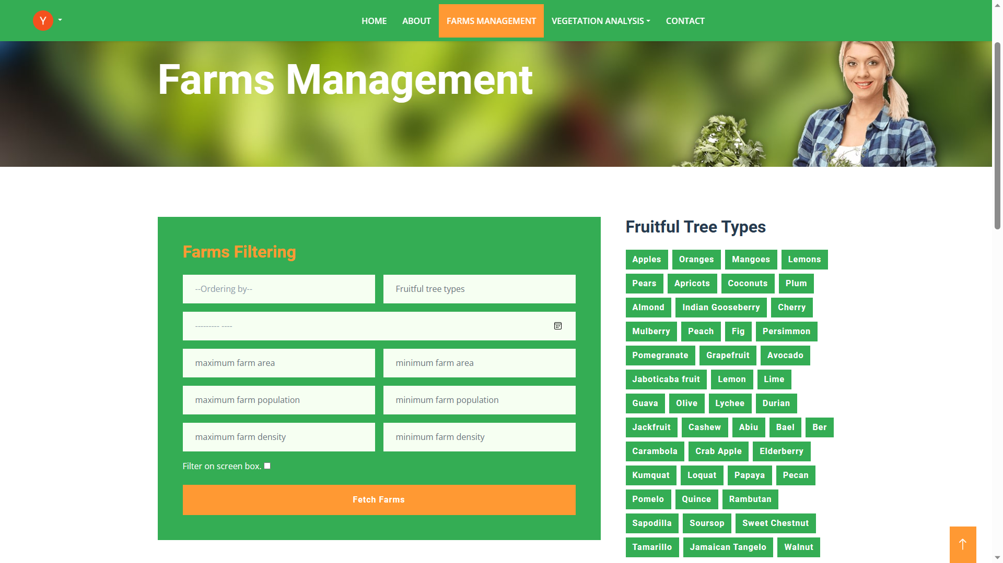
8

Slide 9
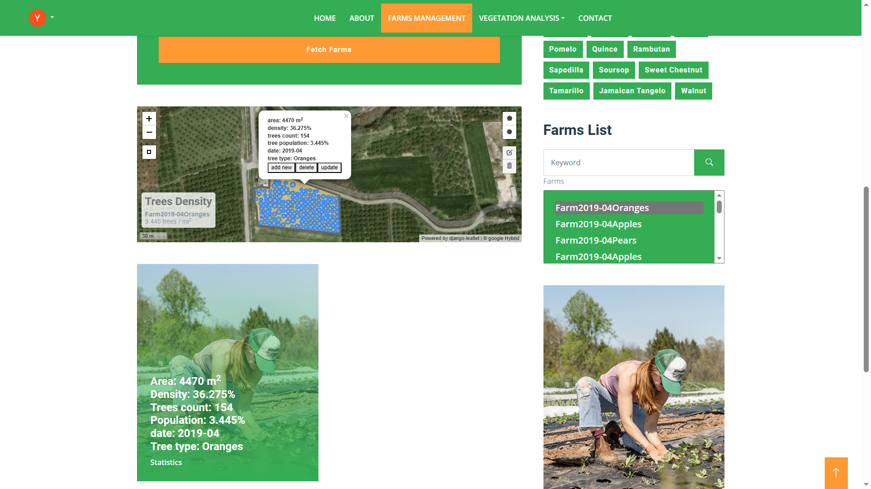
9

Slide 10
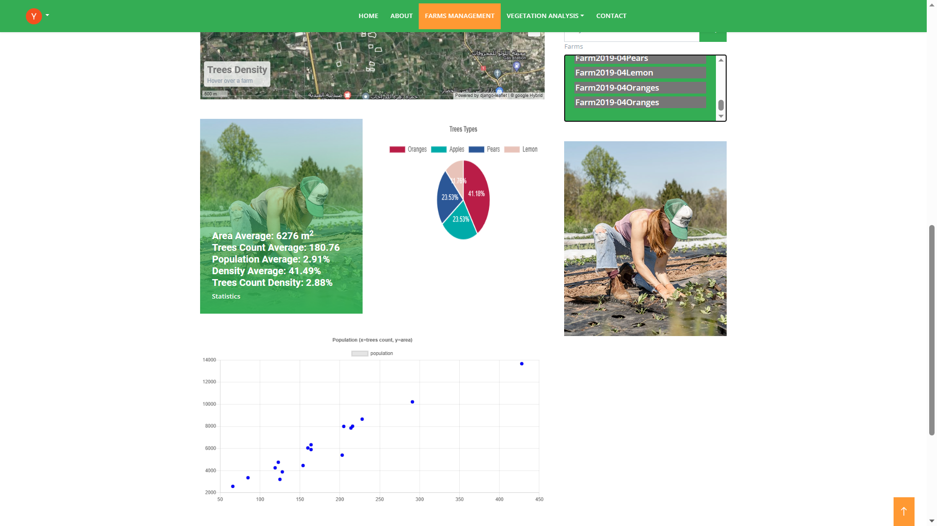
10

Slide 11
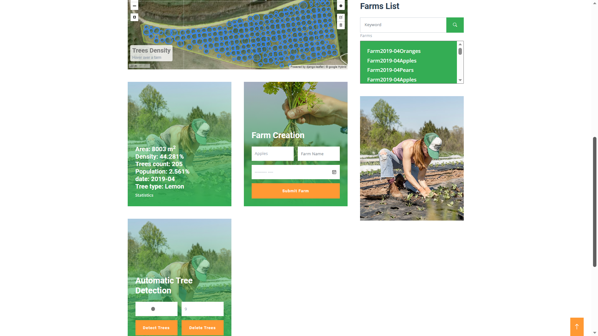
11

Slide 12
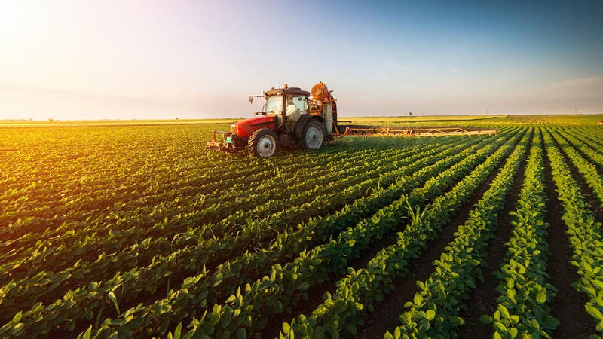
11
Vegetation Analysis
12

Slide 13
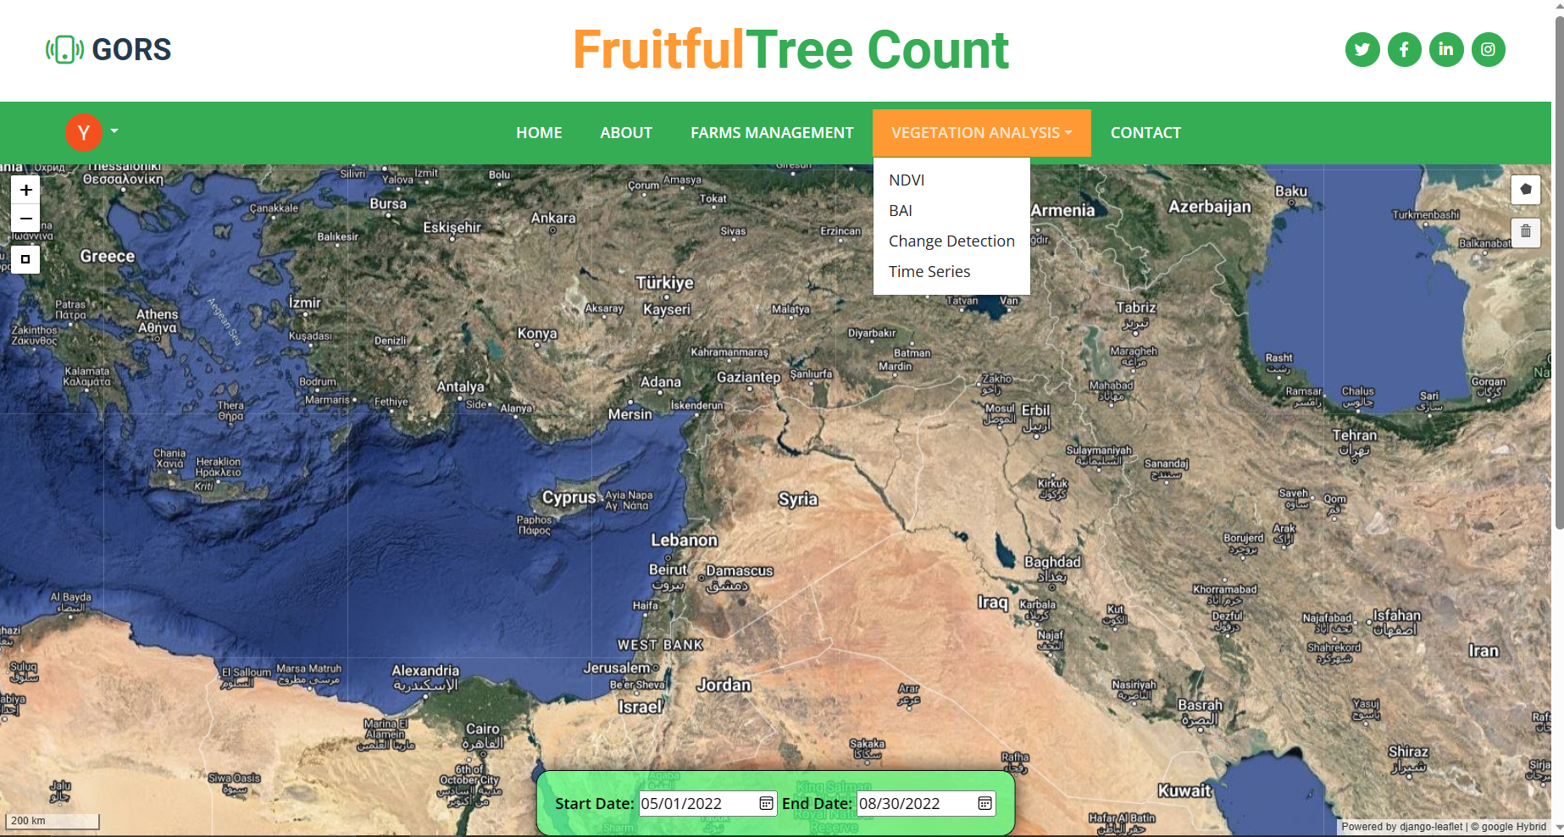
13

Slide 14
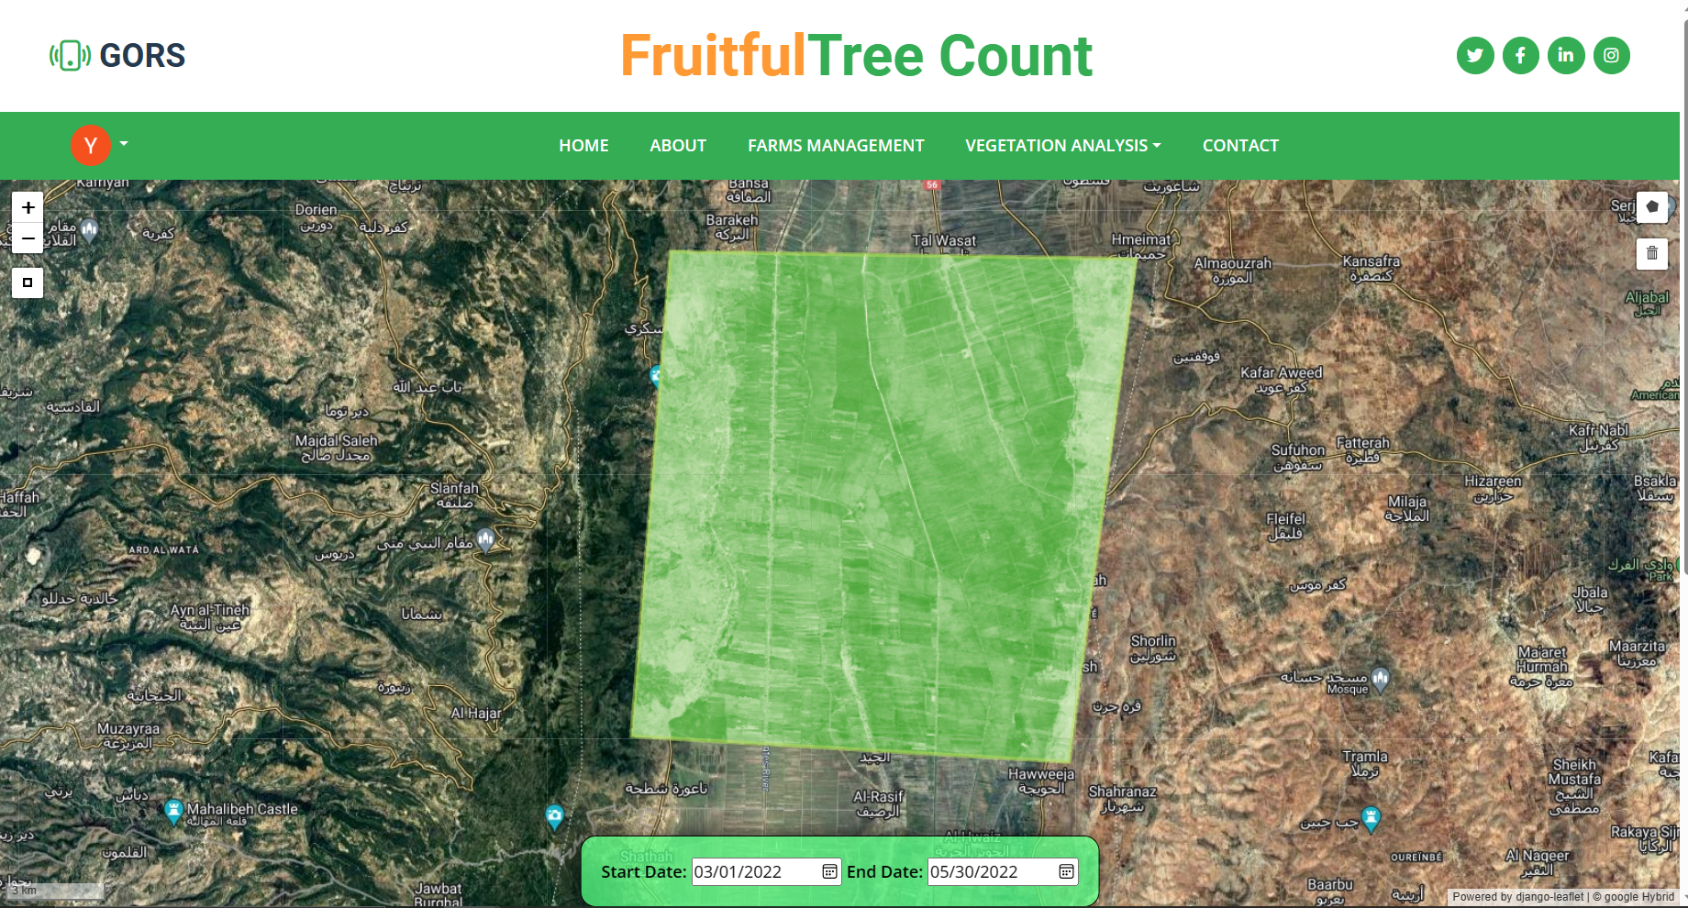
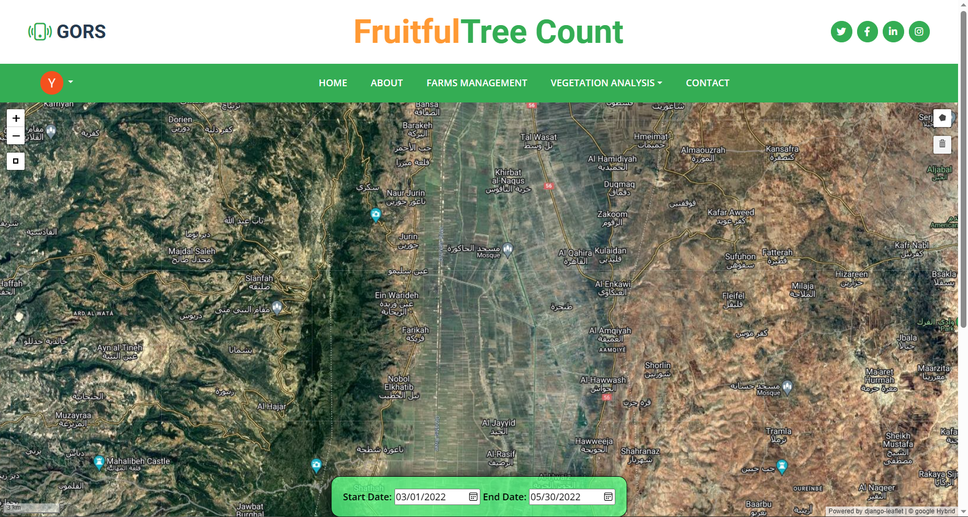
NDVI
14

Slide 15
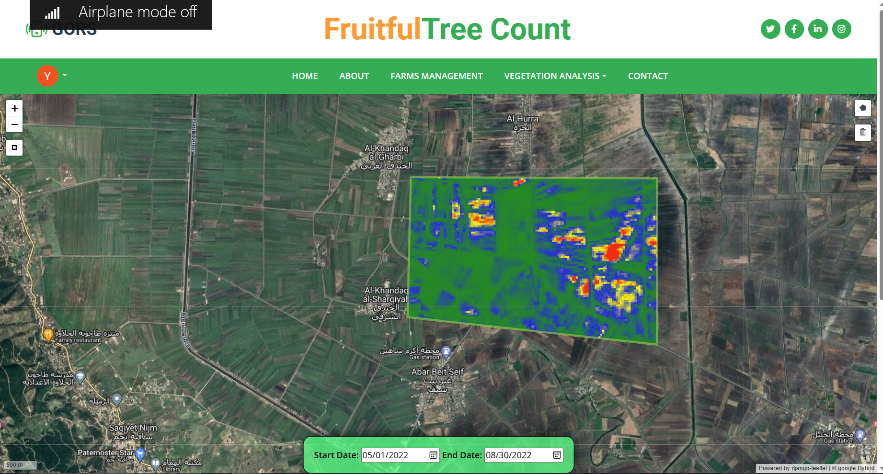
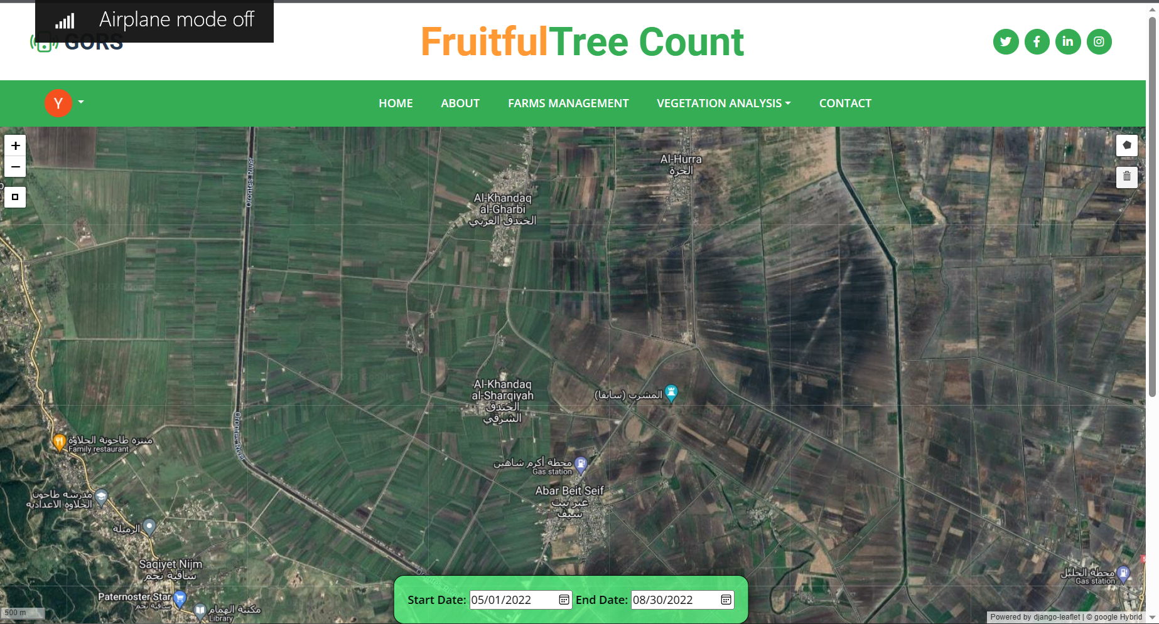
BAI
15

Slide 16
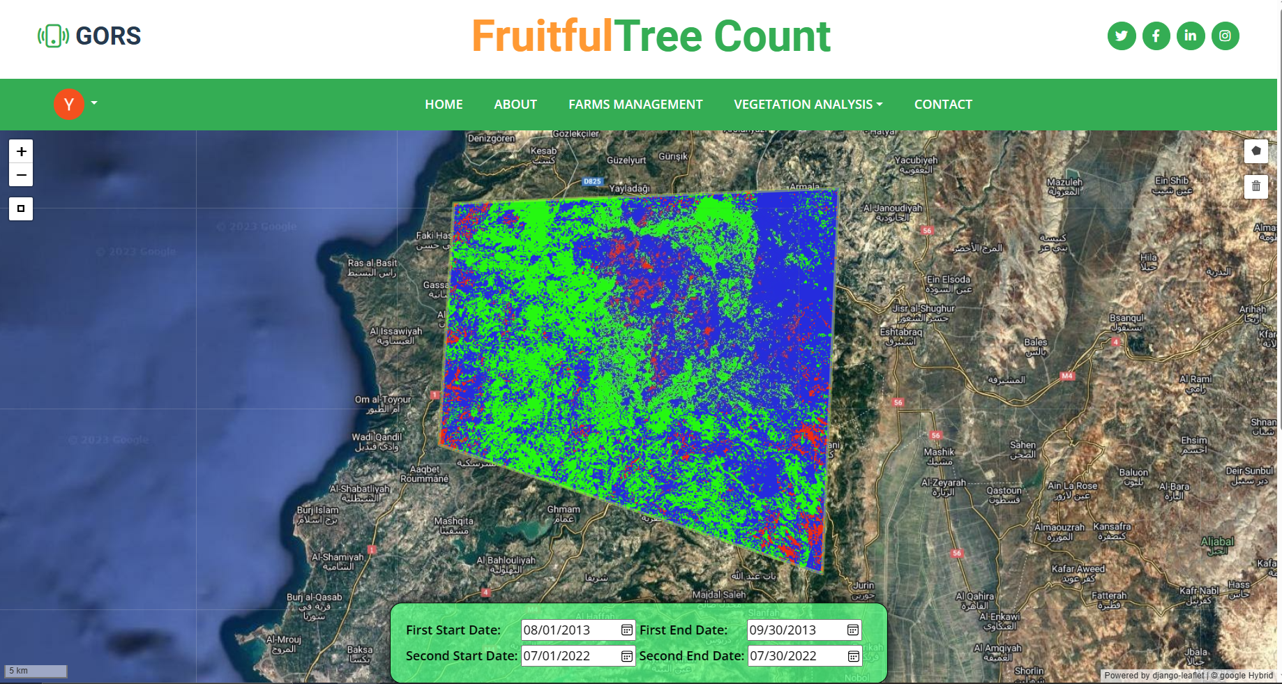
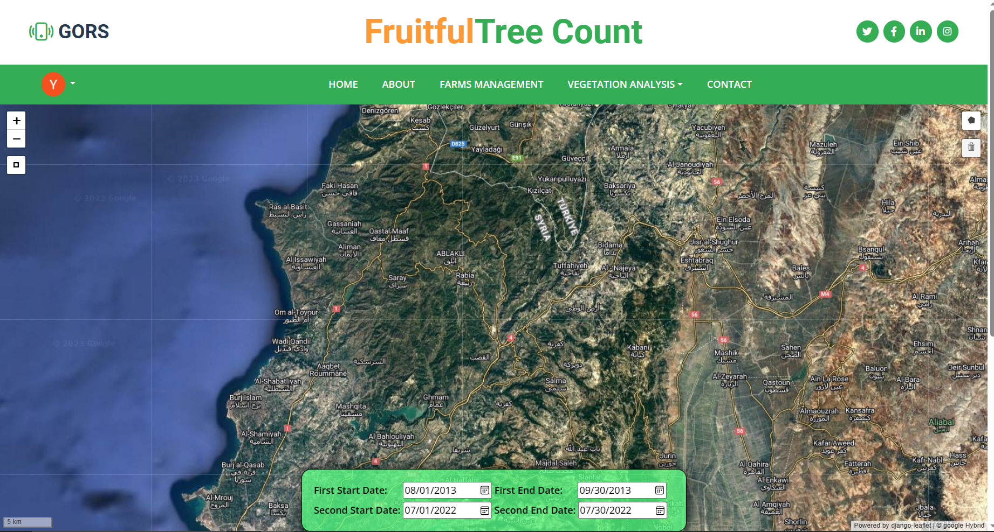
Change Detection
16

Slide 17
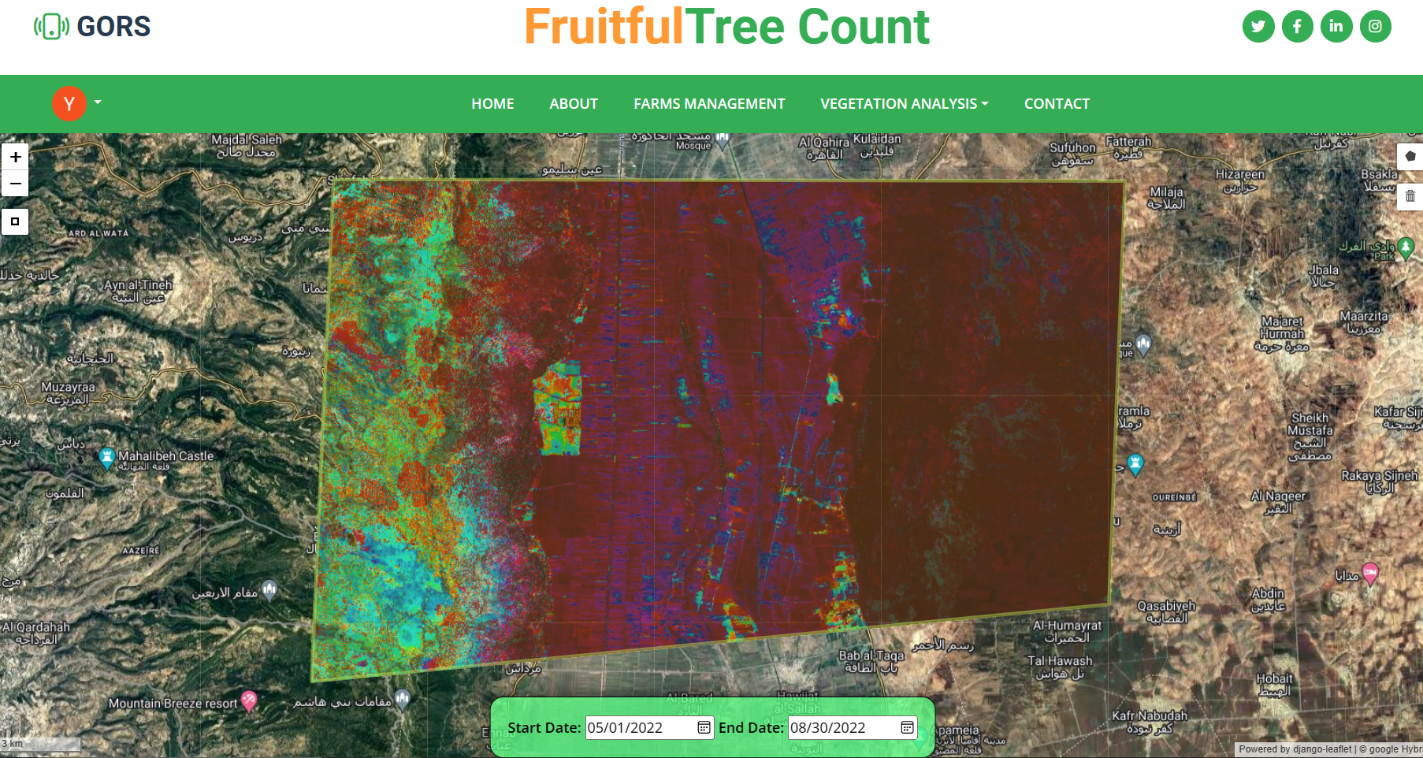
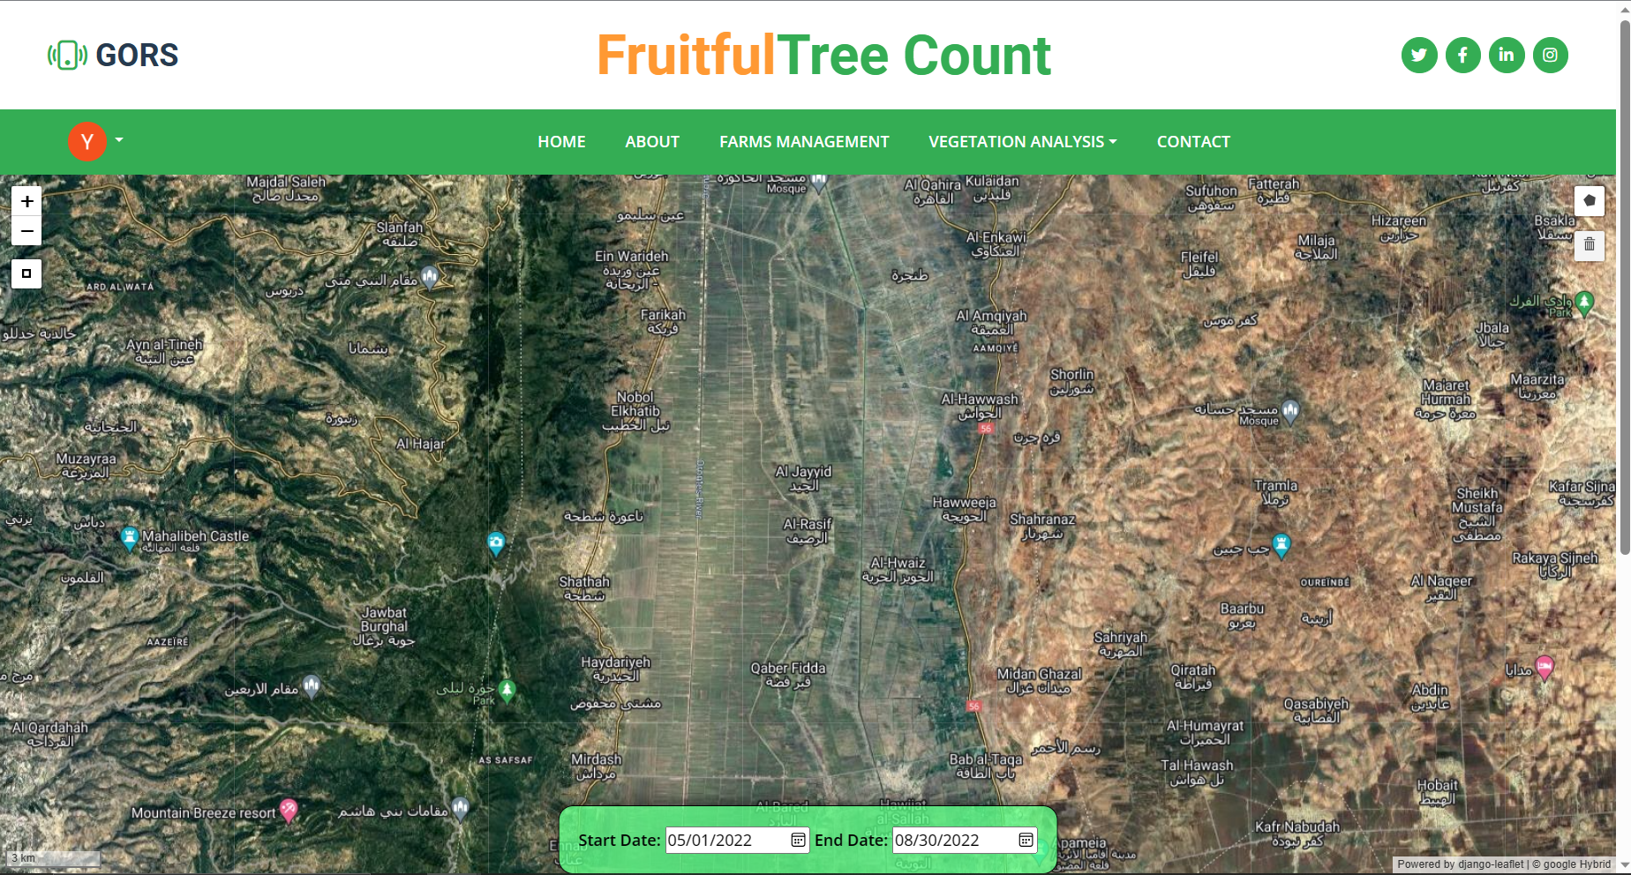
TimeSeries
17

Slide 18


The Challenges
18

Slide 19
Trees Counting
19

Slide 20
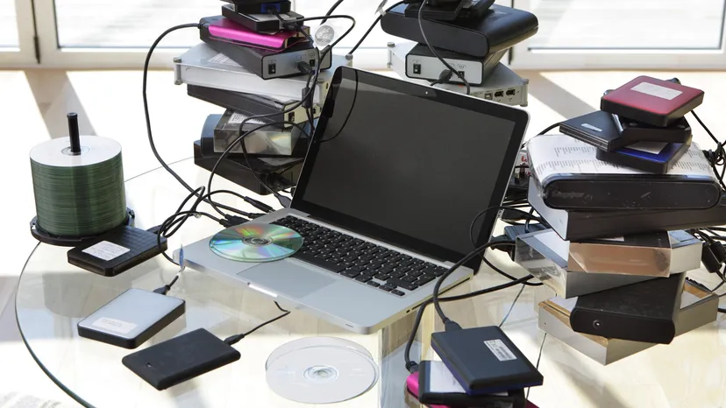
Limited Resources
20

Slide 21

Architecture
21

Slide 22
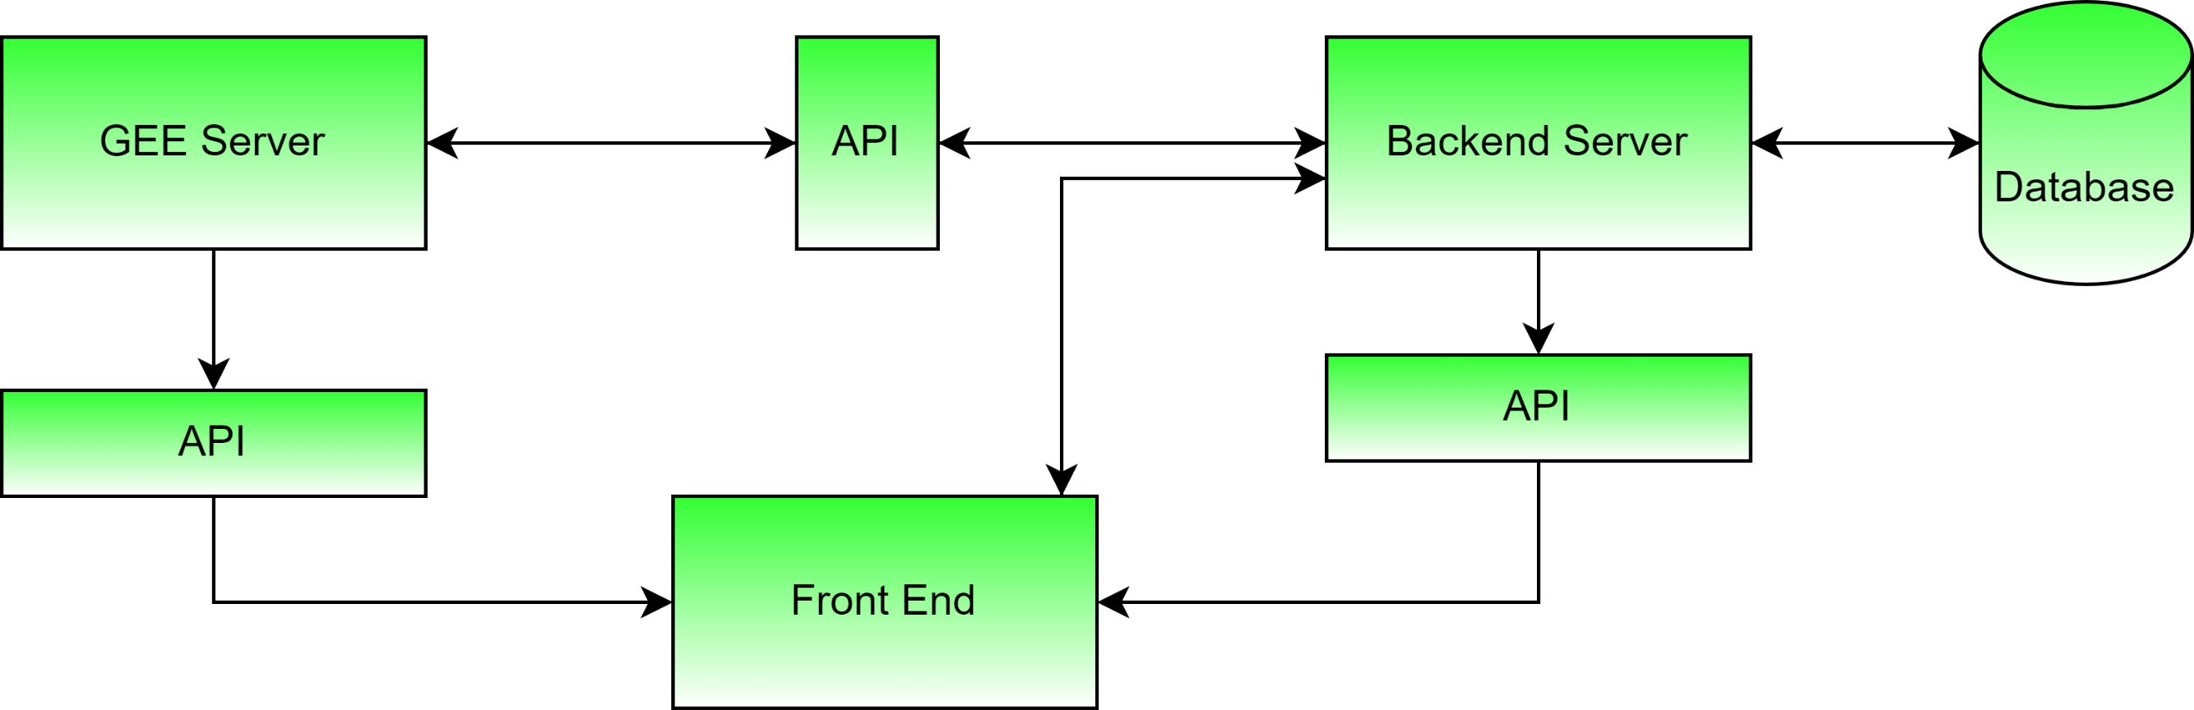
22

Slide 23
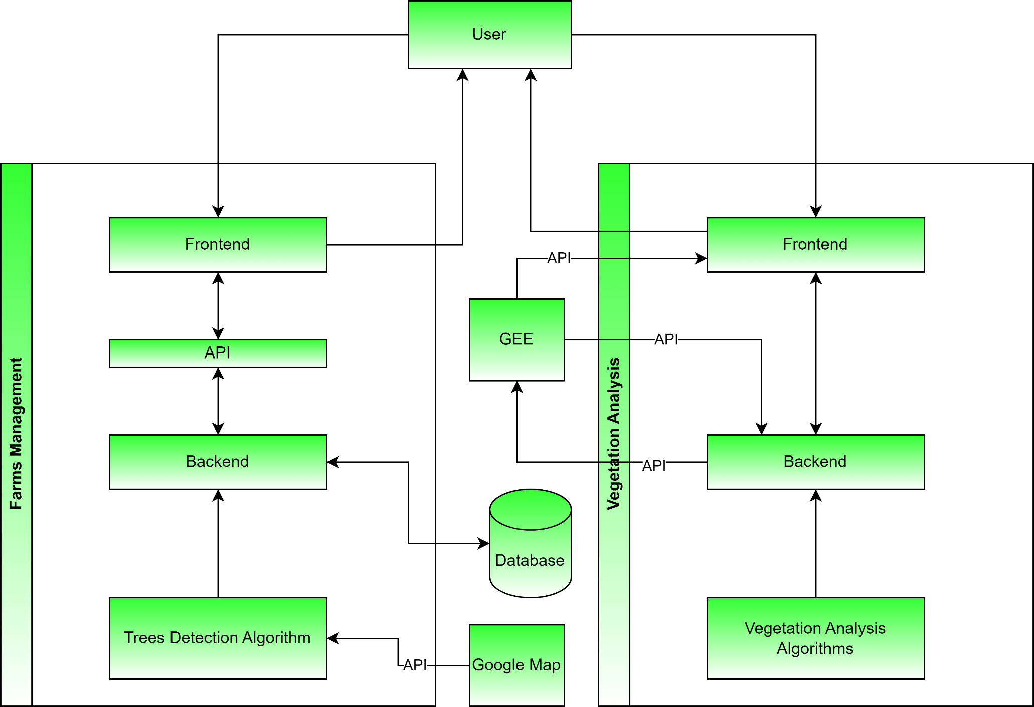
23

Slide 24
Implementation
24

Slide 25
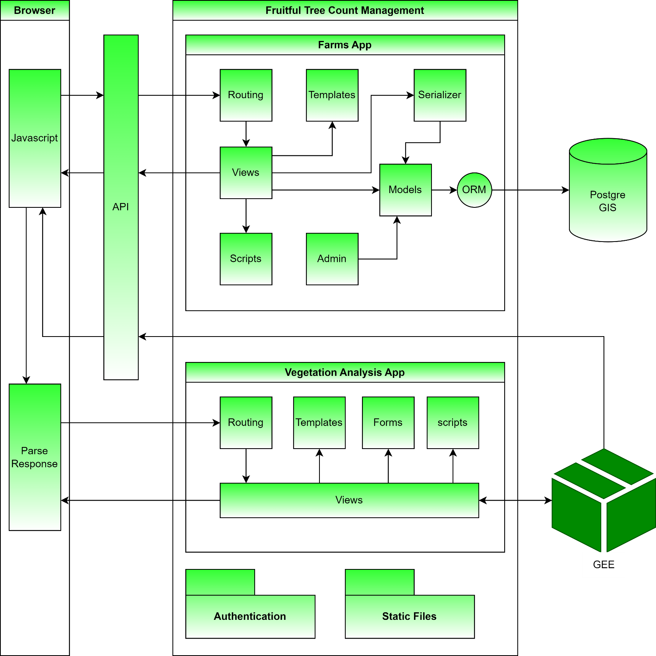
25

Slide 26
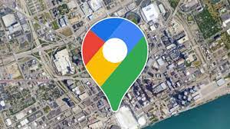





26

Slide 27
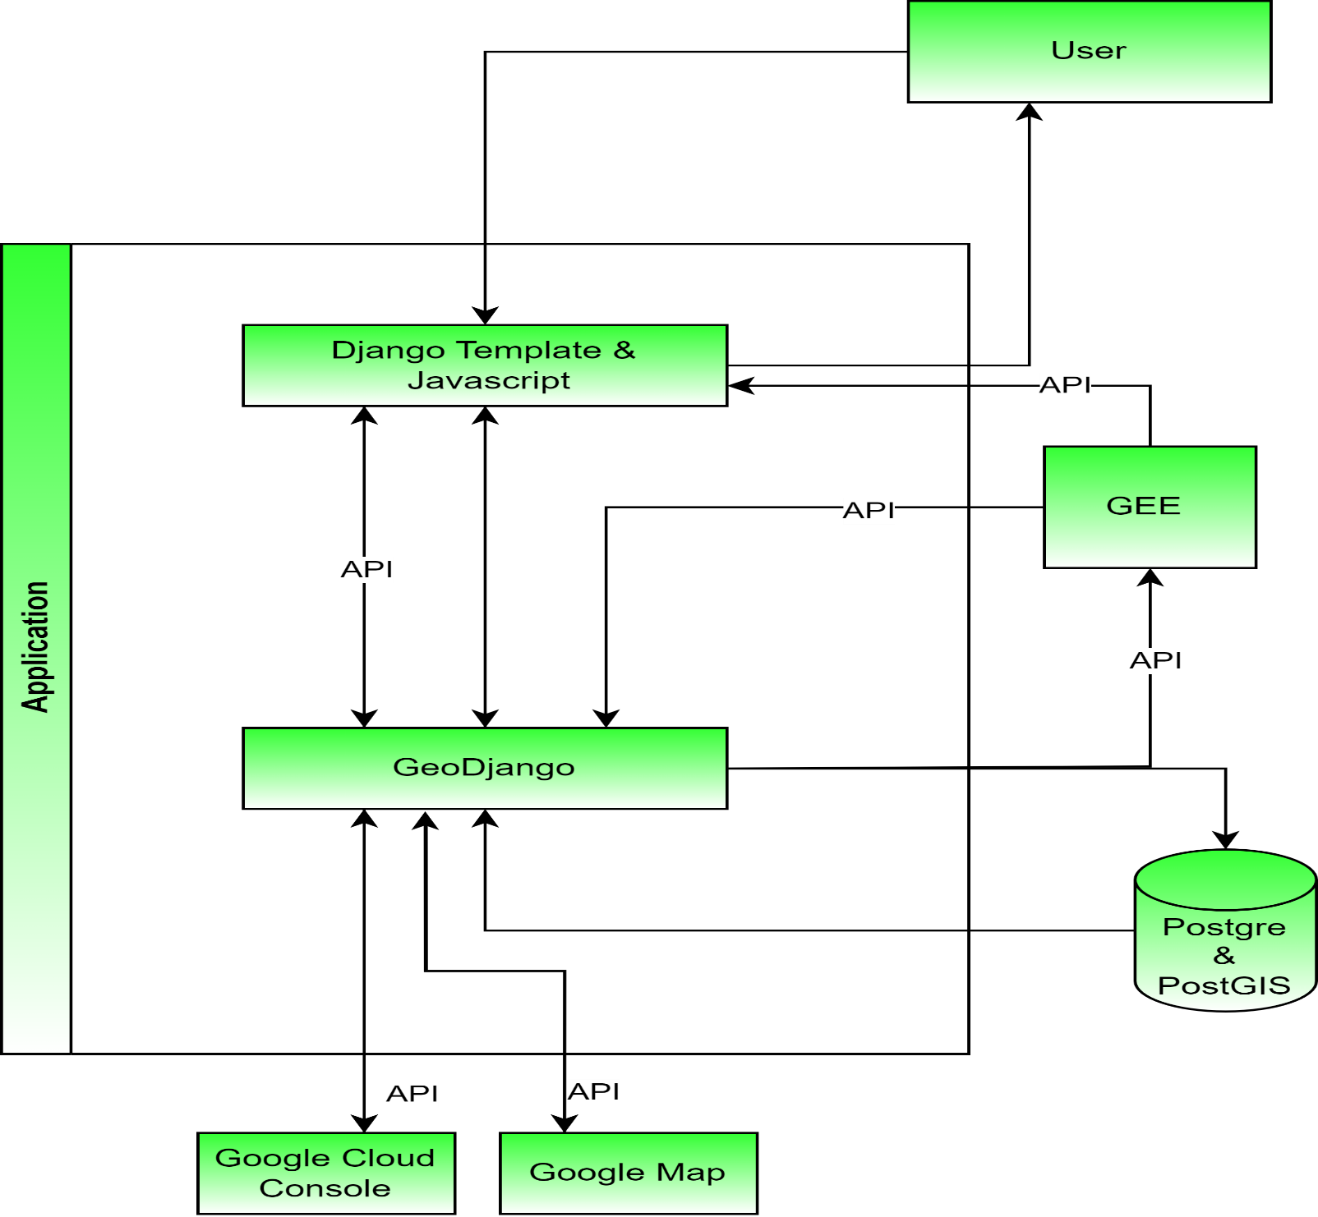
27

Slide 28
Template Matching
Normalized Difference Vegetation Index
Burn Area Index
change Detection
TimeSeries
28

Slide 29
Results
29

Slide 30
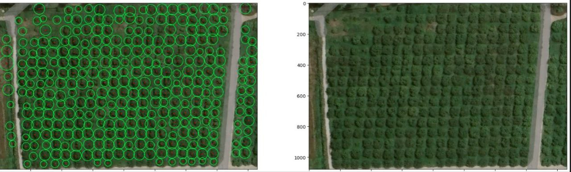
30

